Slide 1

VIT BHOPAL SIMULATION OF
VIT BHOPAL
Review on Robotic Project : Skill up
On
“UVD ROBOT”
Date-19/02/2022
Presented by :
Siddhi Manglam
20BCE10550

Slide 2
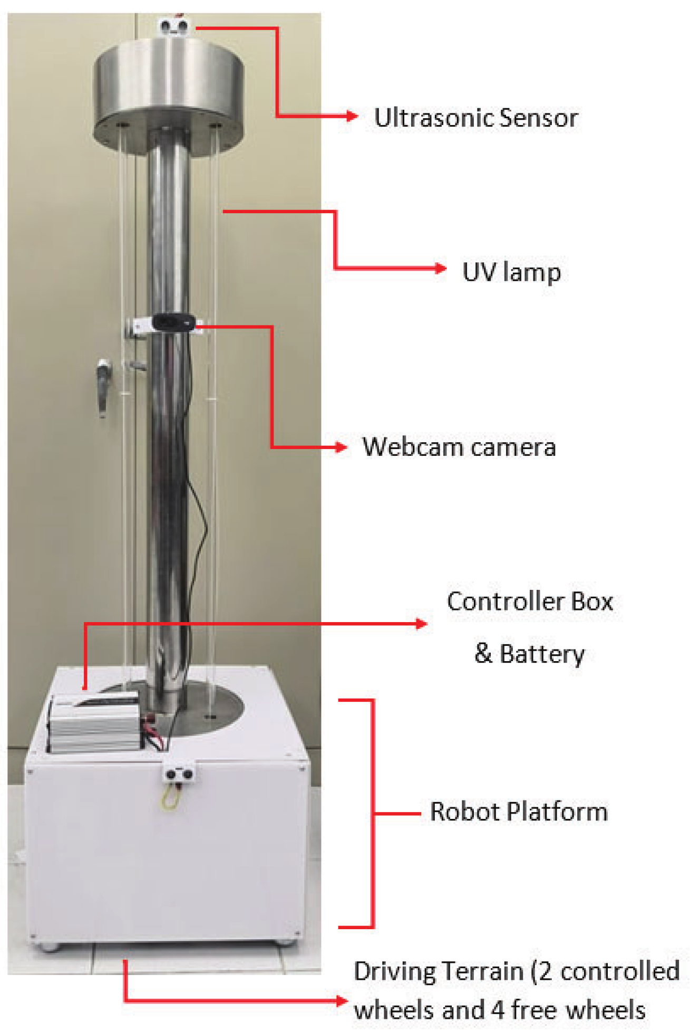
CONTENT-
INTRODUCTION
UVD ROBOT
LITERATURE REVIEW
COMPONENTS
METHODOLOGY
BLOCK DIAGRAM
SIMULATING SOFTWARE
CIRCUIT
RESULTS
CODE
COMPARISION
ADVANTAGES
DRAW BACK
FUTURE SCOPE
NOVELTY
TESTS
CONCLUSION
12) REFERENCE

Slide 3

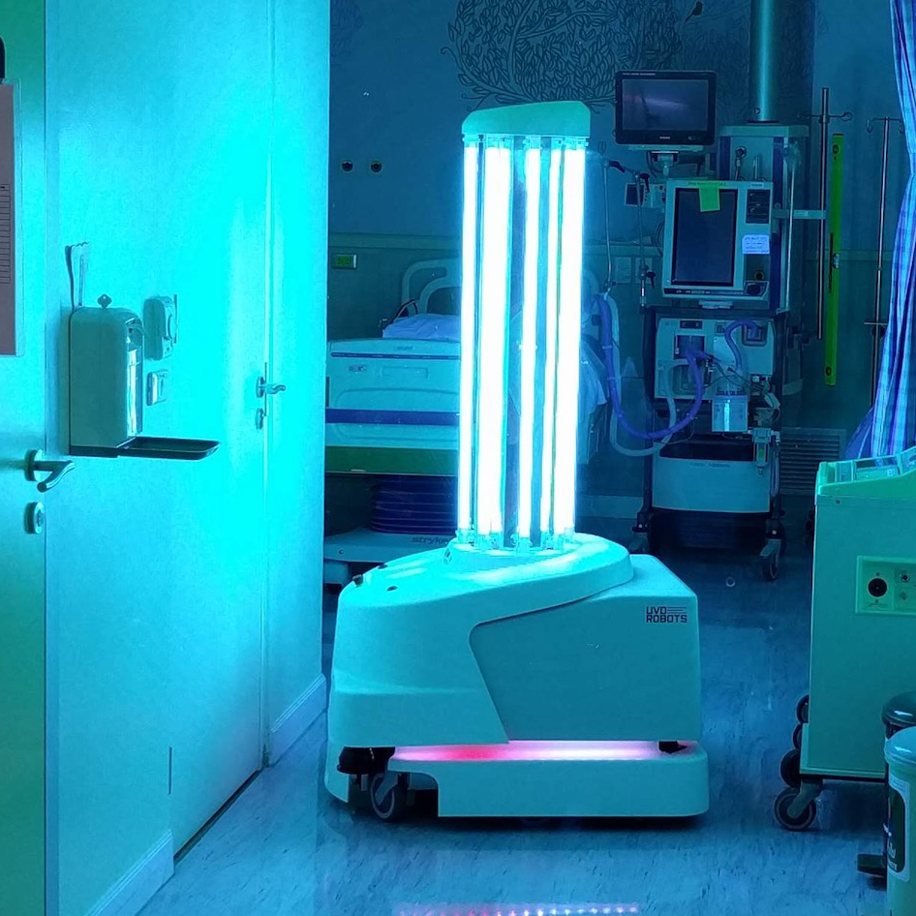
Introduction
The UVD(ultraviolet disinfecting ) robot is developed by BLUE OCEAN robotics in collaboration with leading hospitals in Scandinavia.
The robot is designed to ensure a cost efficient and reliable measure and removal of the overall level of bacteria and viruses, and thereby increasing the operation time of the hospital
limiting the number of patient complaints and securing high quality service, better patient experience and higher success rate.

Slide 4
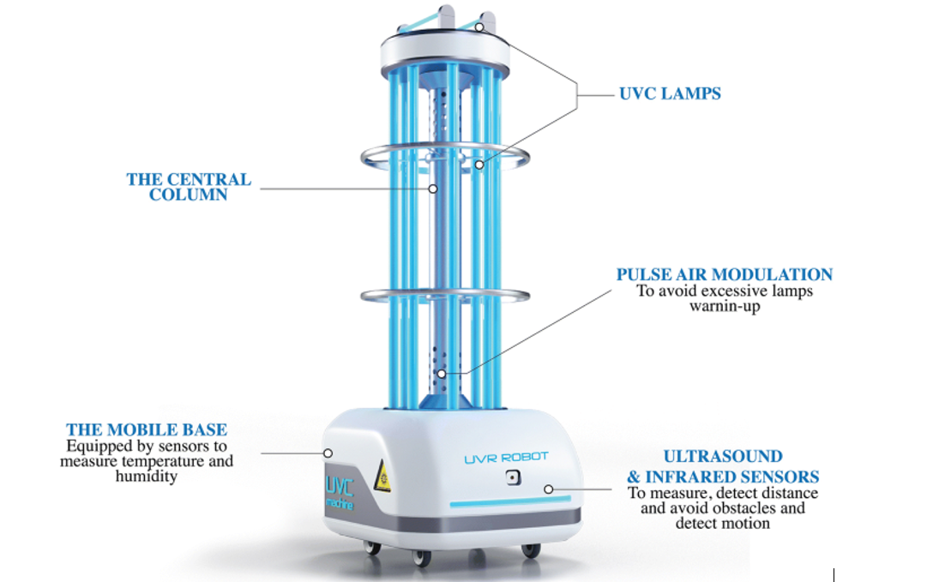

Slide 5
LITERATURE REVIEW

Slide 6
DC motor- it allow the robot to be battery powered, which offers great advantages for a variety of robotic applications.
A 9V battery is actually composed of flat packs in series. These batteries have very tiny capacitances, at most that can be found at 500 mA. These batteries can be used to power up certain electronic components of the robots like the microcontroller and other low power drawing electronics in the robot like sensors.

Slide 7
Ardino uno- The Motor Board controls the motors, and the Control Board reads sensors and decides how to operate. Each of the boards is a full Arduino board programmable using the Arduino IDE.
H-bridge motor driver-The H-bridge arrangement is generally used to reverse the polarity/direction of the motor, but can also be used to 'brake' the motor, where the motor comes to a sudden stop, as the motor's terminals are shorted, or to let the motor 'free run' to a stop, as the motor is effectively disconnected from the circuit.

Slide 8
UVD light-high intensity light sources to think disruptive robot technology in ways that improve work environment, patient safety levels and operational efficiency for customers.
Ambient light sensor - It is compatible with Arduino and is very easy to interface with microcontrollers and logic circuits.
Ultrasonic sensor-An ultrasonic sensor is an instrument that measures the distance to an object using ultrasonic sound waves. An ultrasonic sensor uses a transducer to send and receive ultrasonic pulses that relay back information about an object's proximity.

Slide 9
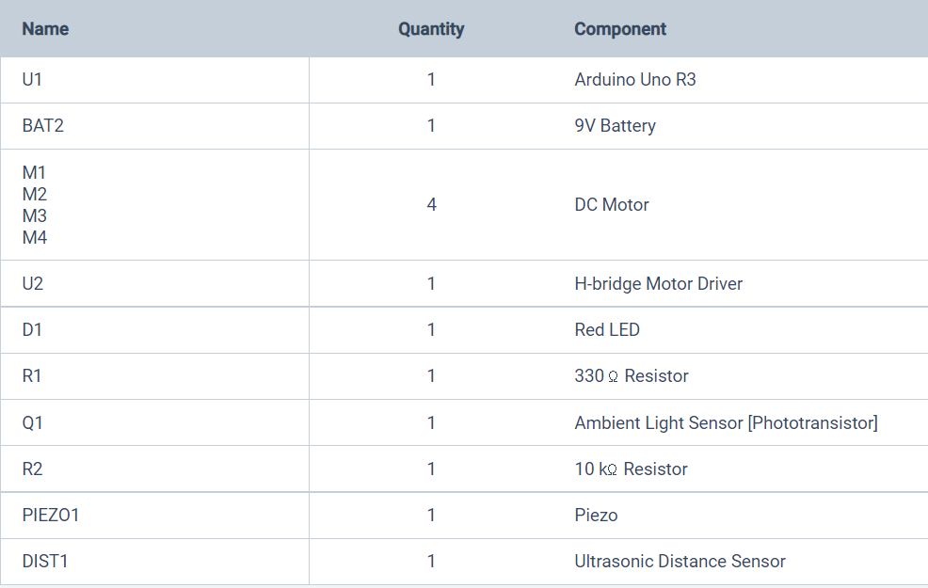
COMPONENTS

Slide 10
METHODOLOGY

Slide 11
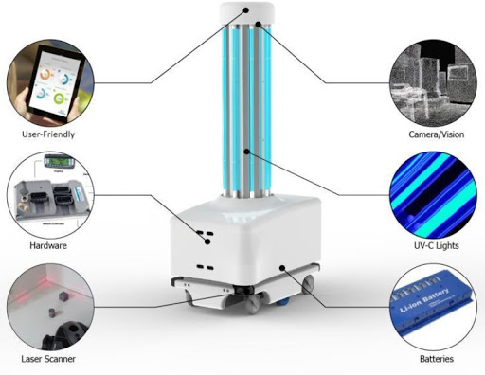
UVD robots include Xener,Tru-D,puro lightning and surfacide.
The UVD Robot is powered by Li-MNC batteries that gives the power to disinfect larger areas.
The UVD Robot comes with laser scanners and 3D cameras that recognize obstacles and recesses on its way.

Slide 12
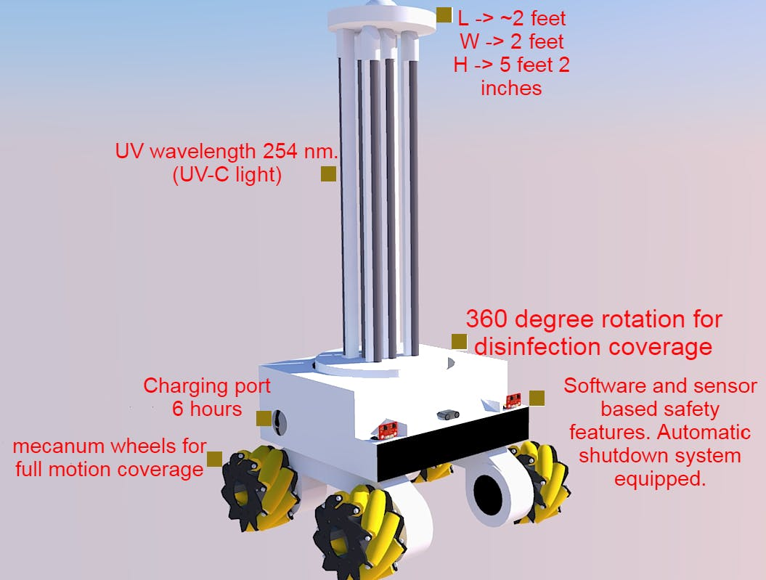

Slide 13
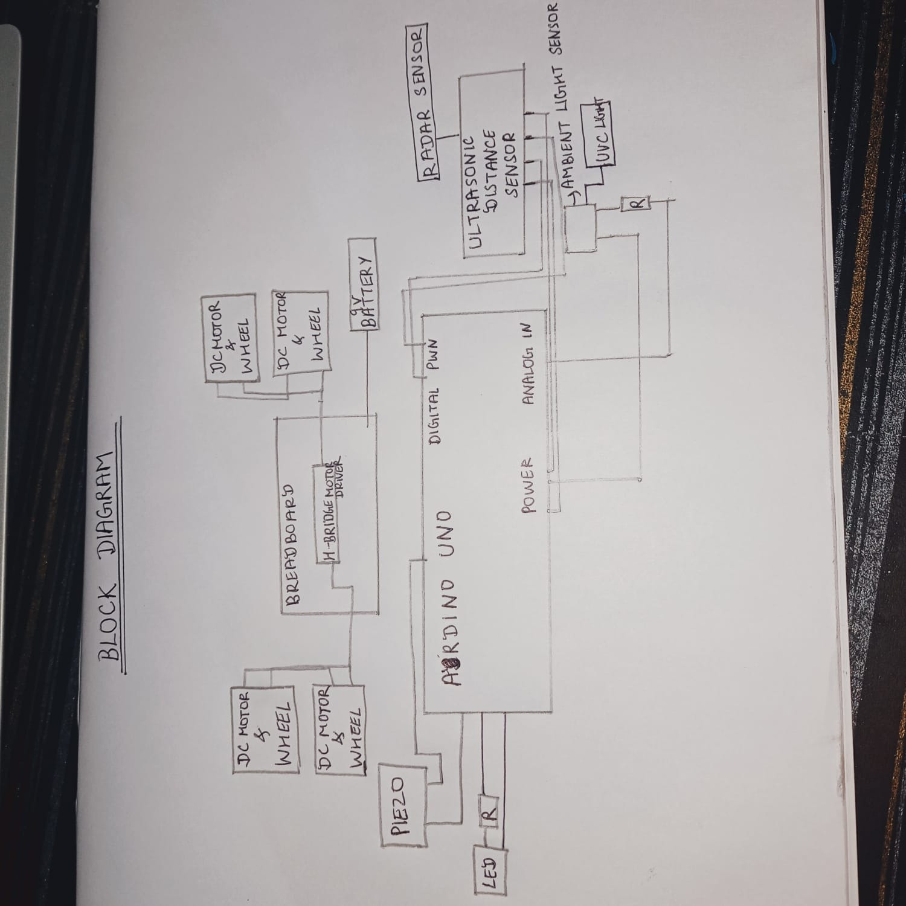
BLOCK DIAGRAM

Slide 14
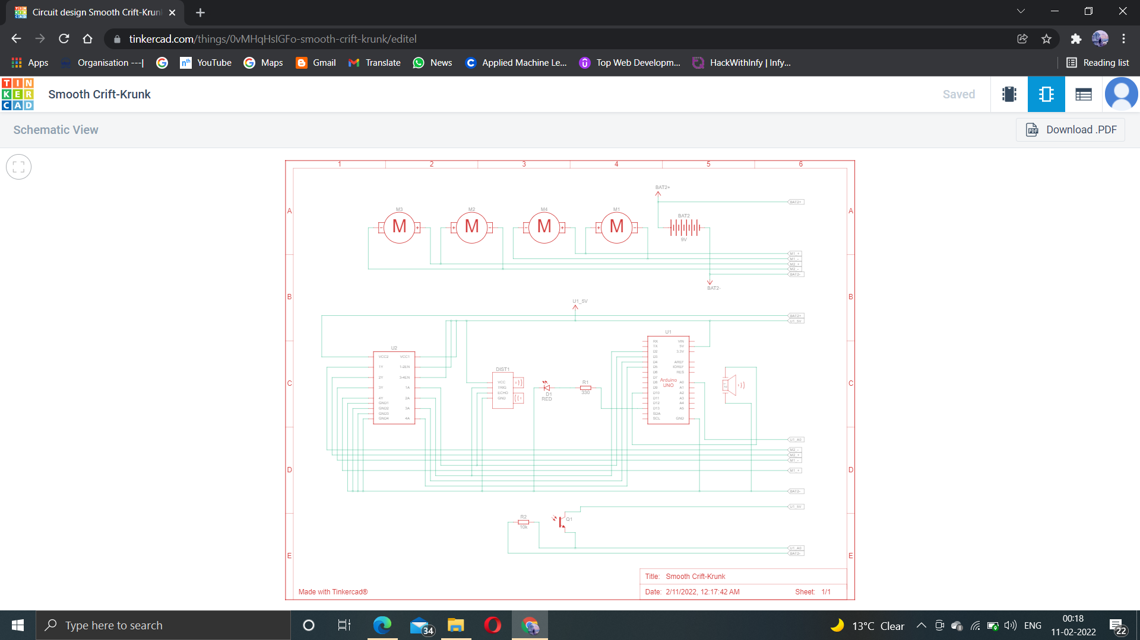

Slide 15
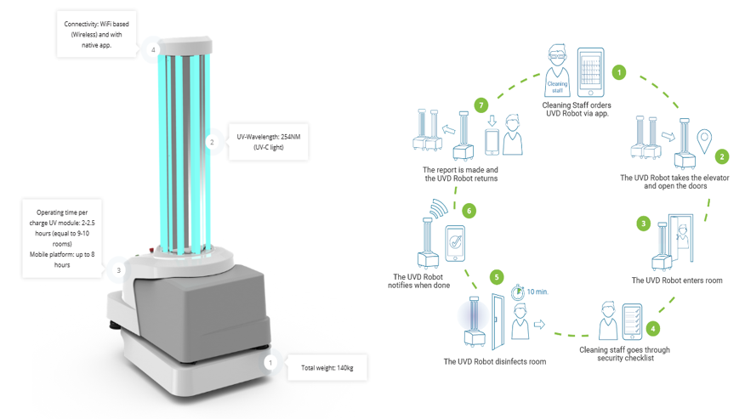

Slide 16
SIMULATING SOFTWARE
TINKERCAD

Slide 17
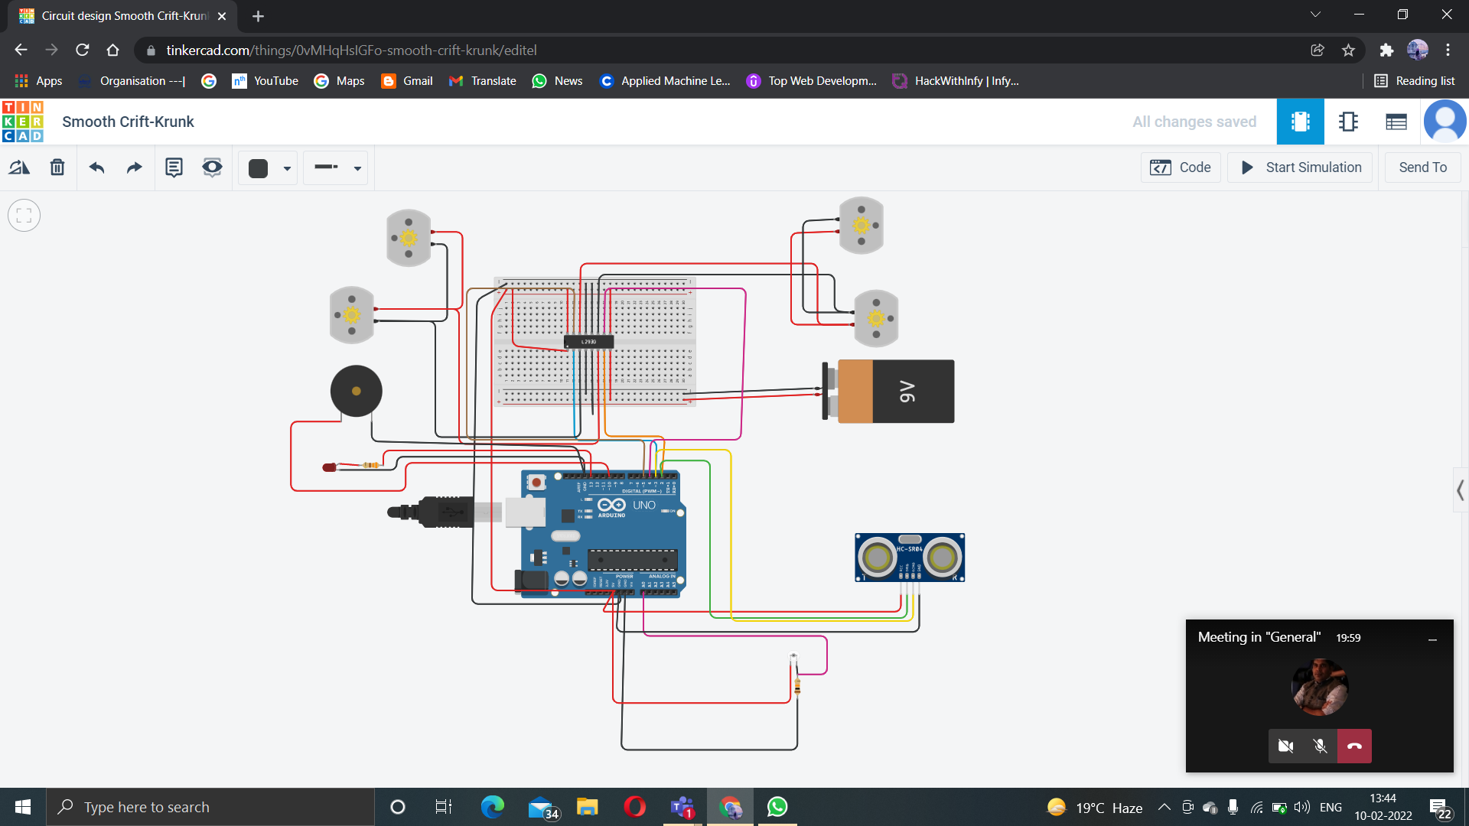
CIRCUIT DIAGRAM-

Slide 18
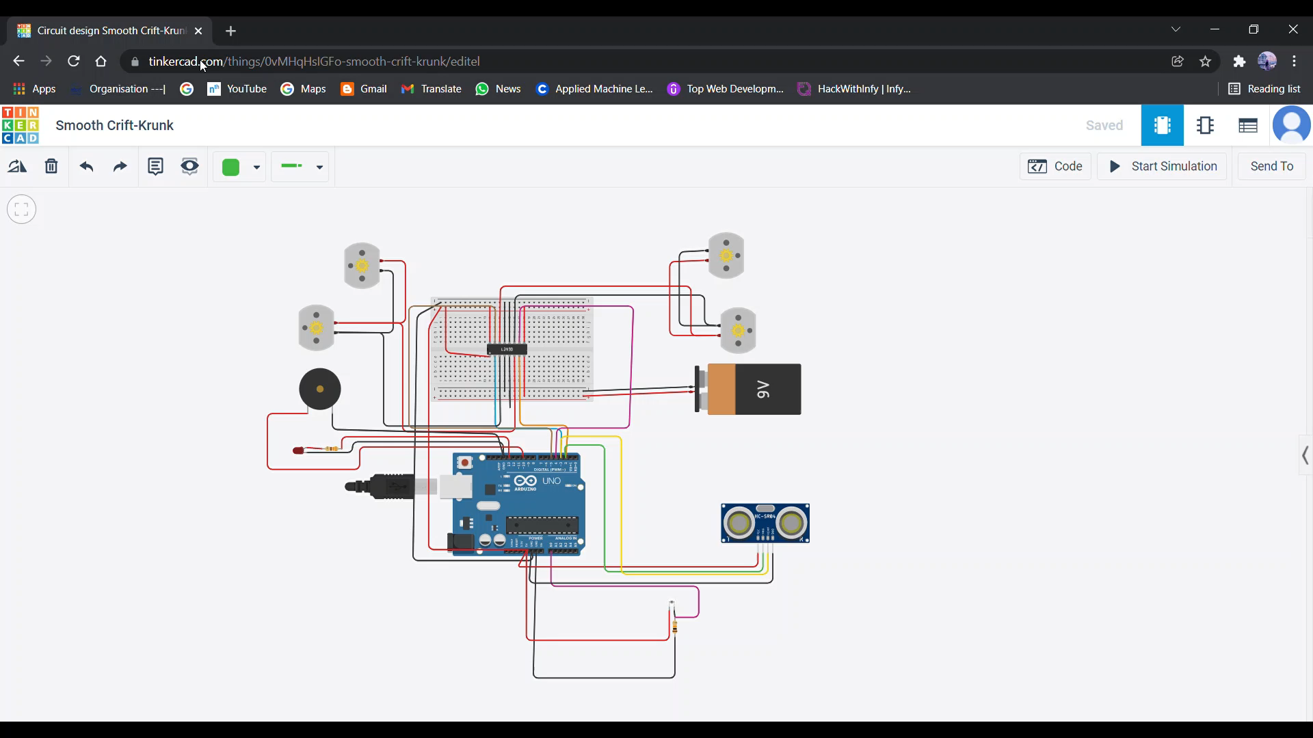
RESULT

Slide 19
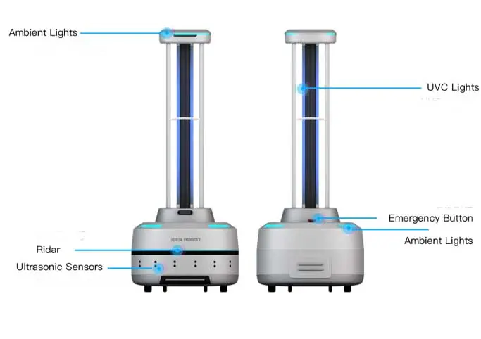

Slide 20
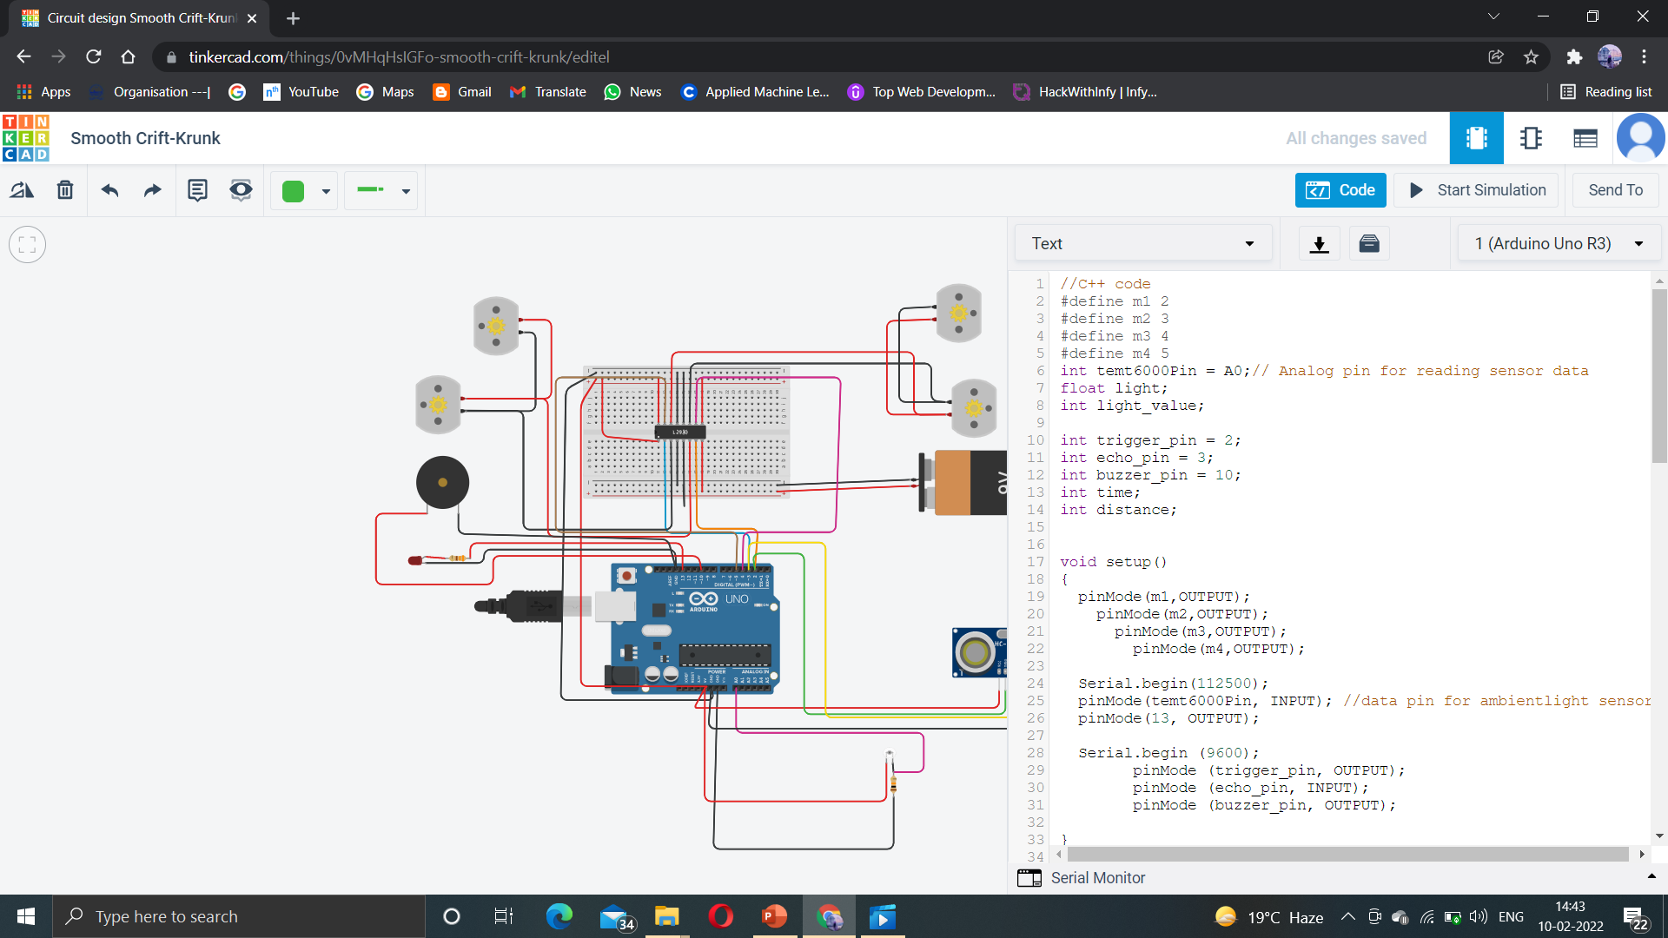
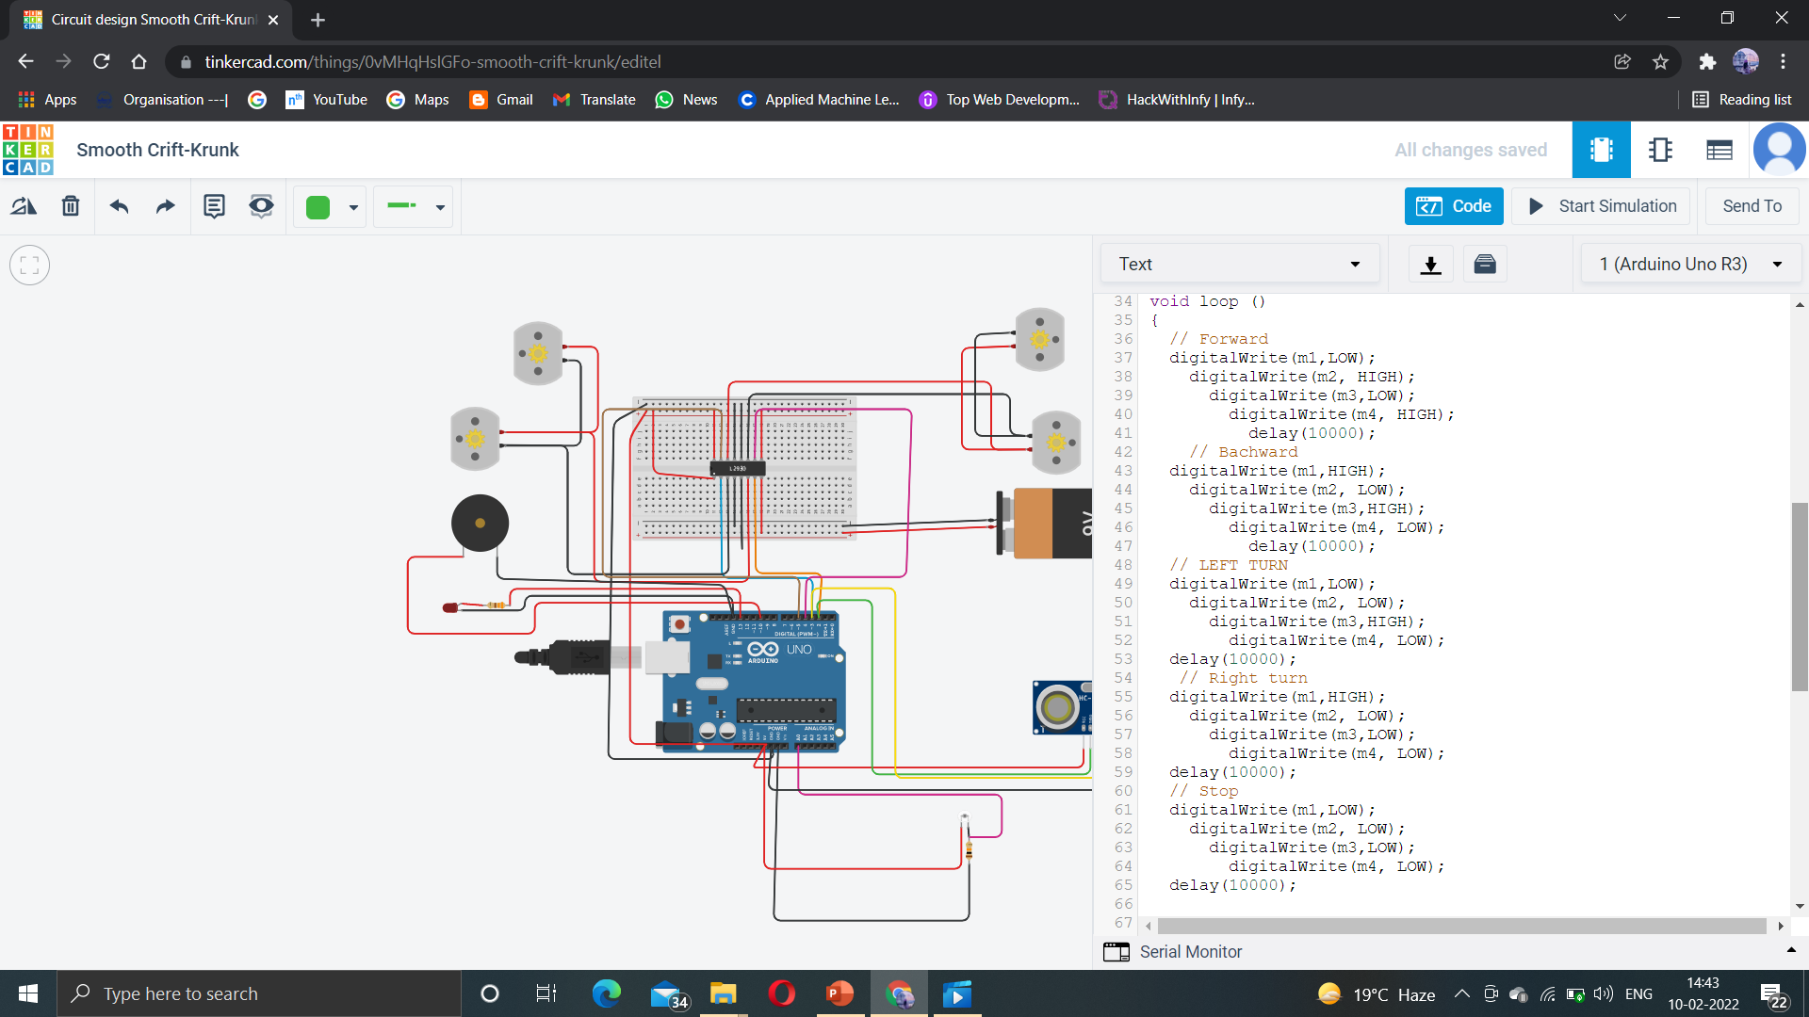

Code

Slide 21
COMPARISION
MANUAL UV-C DEVICE
UVD ROBOT
Total disinfecting time -20 hours
Labour time 20 hours
No sensor used to detect obstacle
Total disinfecting time 90 min
Labor time 3 min
Sensor can detect obstacle

Slide 22
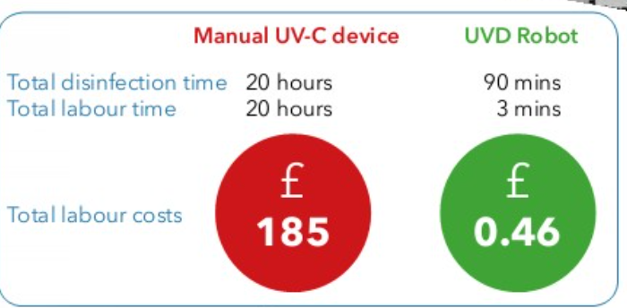
Advantages
Can kill germs up to 99.99%.
Can prevent infectious diseases example COVID-19.
Reliable
Eliminates human error
Improve patient safety

Slide 23
Disadvantage-
Turnaround times for single rooms in hospitals need to be short, given high bed occupancy levels in many countries.
UV-C robots will need additional time that interferes with daily hospital routines. Thus their use must be integrated in to the workflow of hospitals.

Slide 24
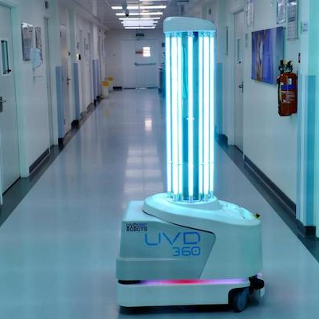
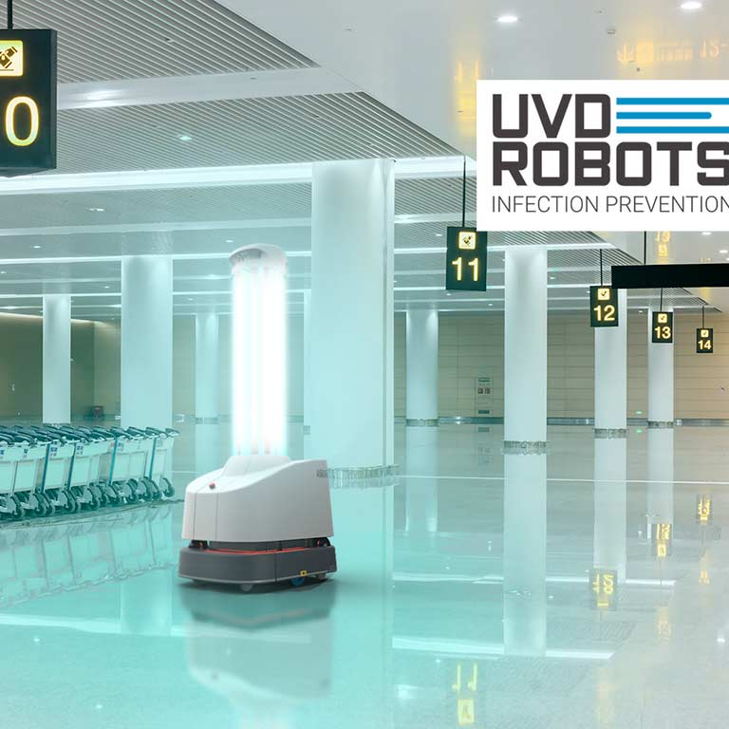
Future scope
Medical
Scientific
Industrial
Institution

Slide 25
NOVELTY
We can include some more features to it like they pick up items ,move object, open and close door while disinfecting the room with UV light.

Slide 26
Tests on UVD robot
Disinfection test-for testing the efficiency of the UVDR in disinfecting task.
1
User interaction test-test the web interface where the user managed and interacted with the robot and the sever.
2
AGV test- testing the existing function of mapping ,path planning and automatic movement of UVDR to assess if the robot works in hospital environment or not.
3

Slide 27
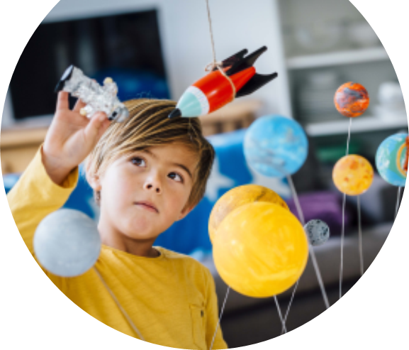
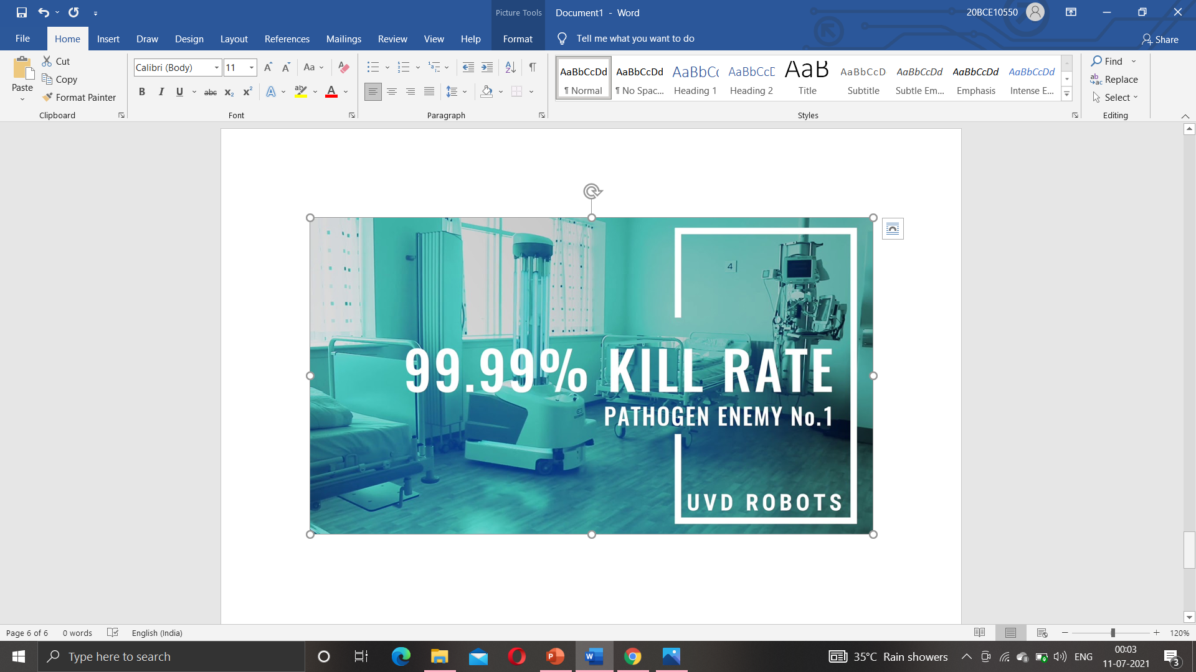
CONCLUSION-
Blue Ocean Robotics see a huge potential with the UVDisinfection Robot in reducing viruses, and providing a better hygiene standard for existing and future hospitals.
The robot has been tested at one of the biggest hospitals in Denmark, Odense University Hospital (OUH) in collaboration with one of Europe’s most respected microbiology groups.
The test showed a significant reduction in bacteria when the bacteria was exposed to the UV-Disinfection Robot’s UV-light.

Slide 28
Reference-
https://www.uvd-robots.com/

Slide 29
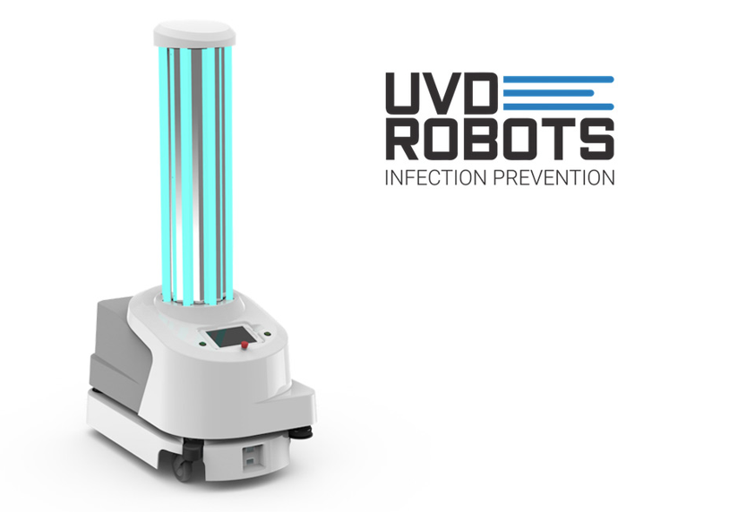
Thank you
-SIDDHI MANGLAM

